Slide 1
Locking Techniques for Concurrency Control in Database
-SAGAR GIRI

Slide 2
What is Concurrency Control ?
Concurrency control is the management of concurrent transaction execution. DBMS implement concurrency control to ensure serializability and isolation of transaction.

Slide 3
Locking Techniques for Concurrency Control in Database
Locking is Technique used to control concurrent access to Data.
Locking is the one of the most widely used technique to ensure serializability.
Principle used in locking Technique is as follows.
  "A transaction must contain a read or write lock on data item before it can perform a read or write operation".

Slide 4
The basic rules implemented in locking technique are as follows
If a transaction has read lock on a data item. It can performer only read operation not write.
If a transaction has read lock on a data item and other transaction want to use it then it can implement only read lock not write lock on this data.
If a transaction has write lock on a data item. It can performer Both read operation and write operation.
If a transaction has write lock on a data item and other transaction want to use it then it can't implement neither read lock nor write lock on this data.

Slide 5
Types of locking Technique
The two Phase locking protocol
Time Stamping Protocol
Validation Based protocol

Slide 6
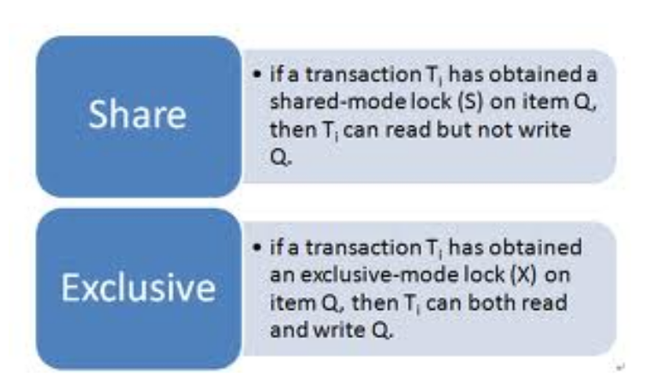
Mode of locking
Their are two made of locking one Shared Mode and other Exclusive mode.

Slide 7
The two Phase locking protocol
The two-phase locking protocol is used to ensure the serializability in Database. This protocol is implemented in two phase :
  Growing Phase
    In this phase we put read or write lock based on need on the data. In this phase we does not release any lock.
  Shrinking Phase
    This phase is just reverse of growing phase. In this phase we release read and write lock but doesn't put any lock on data.

Slide 8
Two Phase Locking (2PL) Protocol
A transaction is two-phased locked if:
  Before reading x, it sets a read lock on x
  Before writing x, it sets a write lock on x
  It holds each lock until after it executes the corresponding operation
  After its first unlock operation, it requests no new lock
Each transaction sets locks during a growing phase and releases them during a shrinking phase

Slide 9
Time Stamping Protocol
In Time stamping Protocol we select sequence of transaction in advance by using Time stamping concept.
We add a special variable time stamp ( a unique, fixed non decreasing ) to each transaction in system. This number can be system clock value.
When a new transaction entered in the system, current value of cock is assigned to transaction as time stamp value. Value of time stamp is incremented every time after a new transaction interred in the system.

Slide 10
Example:
If their are two transaction t1 and t2 in system. Transaction t1 has s1 time stamp value and transaction t2 has s2 time stamp value and s1<s2. In this case Transaction T1 processed first then transaction t2.

Slide 11
Validation Based protocol
Two-phase locking protocol and Time stamping Protocol are slow in working because they worked in two steps, so we use validation based protocol which is faster than Two-phase locking protocol and Time stamping Protocol.
In Validation based protocol, it doesn't update entire data base in one step. It keeps local copies of all updates during transaction execution.

Slide 12
Validation Based protocol works in three steps
1. Read Phase:
  In this step transaction is activated and it reads last committed value from DB and put these value in local variables. All updates implemented in these local variable of database.
2. Validation Phase:
  In this step it check read value during the first phase against current values. It also check consistency of data base after modification performed in database.
3. Write Phase:
  If validation phase say that data base is in consistent state then all update made by transaction which are in local variable are applied in database for permanent storage. If validation phase say that database is not consistent or it violate serializability then it discard/rollback all updates and it restart transactions.

Slide 13
THANKS !

